Slide 1
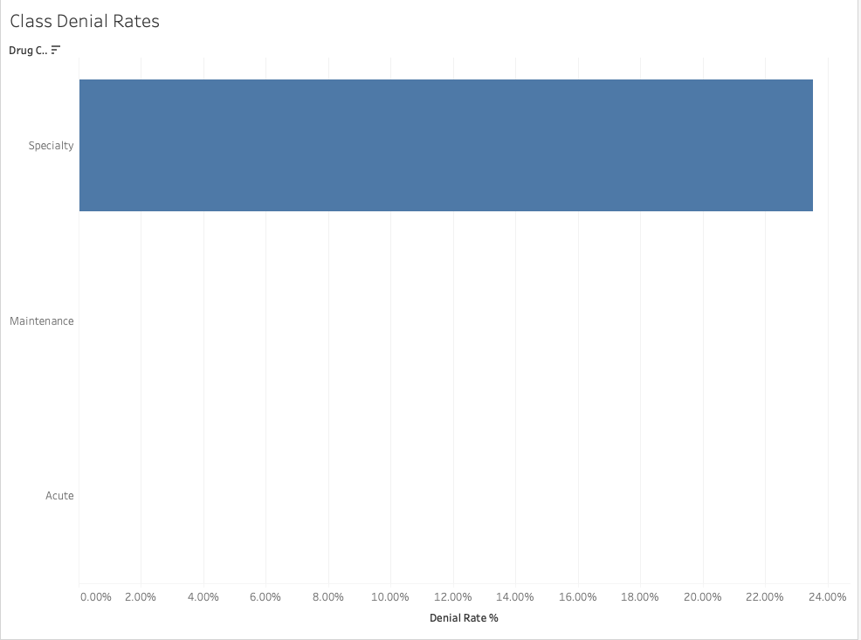
PA rejections triggered a $1.2M revenue leak in Q3 specialty operations
Operational Audit of 10,000 Pharmacy Claims: Q3 Performance Review
TOTAL ESTIMATED REVENUE LOSS
$1,197,600
998 Abandoned Specialty Claims
Specialty Friction: Administrative rejections are isolated entirely within high-cost specialty therapies.
Patient Deterrence: Lengthy "Documentation Required" rejections are causing patients to walk away from therapy before clinical resolution.
Bottom Line Impact: The current manual PA process is creating a seven-figure revenue leak that is 100% preventable via clinical automation.

Slide 2
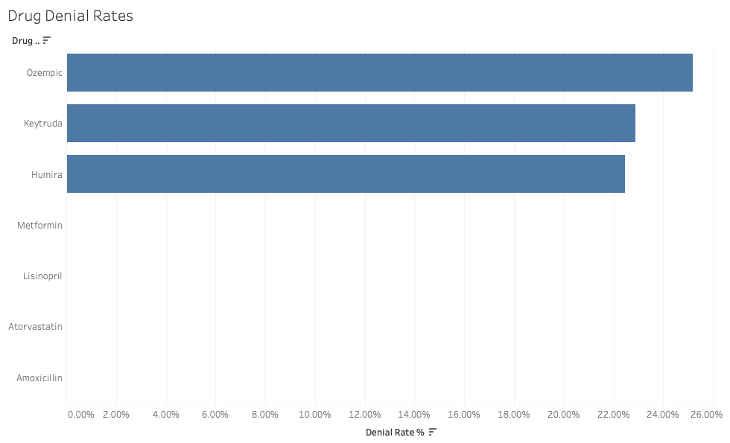
Clinical Exceptions Analysis: Target Core Offenders
Concentrated Exception Failure: Denial patterns are not uniformly distributed; administrative gridlock is heavily isolated within specific high-volume therapeutic lines.
Incomplete Clinic Submissions: Deeper operational audit reveals that clinical administrative rejections are often caused by missing or incomplete clinical documentation submitted by regional clinics.
The Operational Burden: Manual tracking of these "Documentation Required" status codes wastes significant pharmacy technician labor hours on telephone tag and faxing.

Slide 3
Strategic Recommendations: Mitigating Revenue Leakage via Automation
Recommendation 1: Automated ePA Integration. Deploy automated electronic Prior Authorization loops for the "Core Offenders" (Ozempic, Humira) to bypass manual documentation review.
Recommendation 2: The "Clinic Ping" System. Implement an automated SMS/EMR alert that pings regional clinics the moment a submission is flagged as "Incomplete," resolving the documentation gap in real-time.
Recommendation 3: Triage Guardrails. Route any Specialty denial directly to a financial aid dashboard to capture those 998 patients before they leave the pharmacy counter.
The Bottom Line (ROI): Capturing just 35% of currently abandoned therapy cycles results in a projected +$419,000 annual profit recovery.

